Slide 1
SIR Model – With Day 100 Trigger

Slide 2
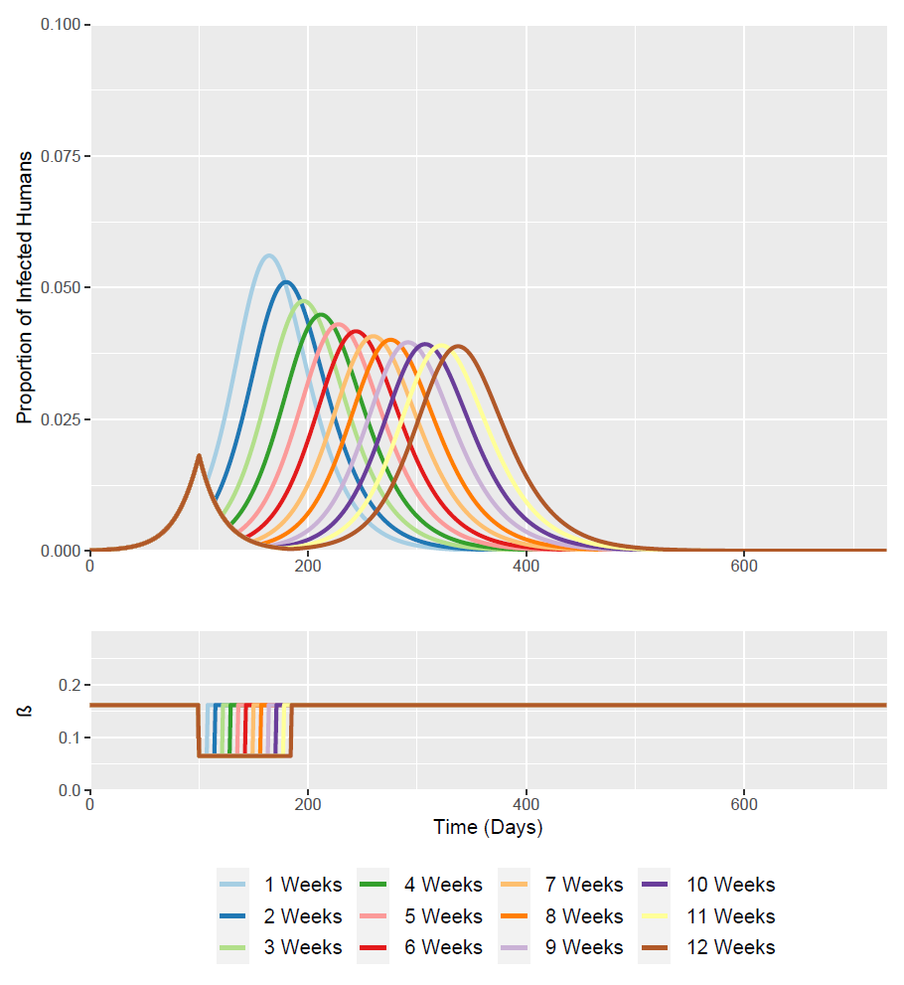
Time of Intervention Trigger =
100 Days (Week ~14.2)
Optimised timing for the two 12 week intervention scenario
I(t = 100) = 0.0182

Slide 3
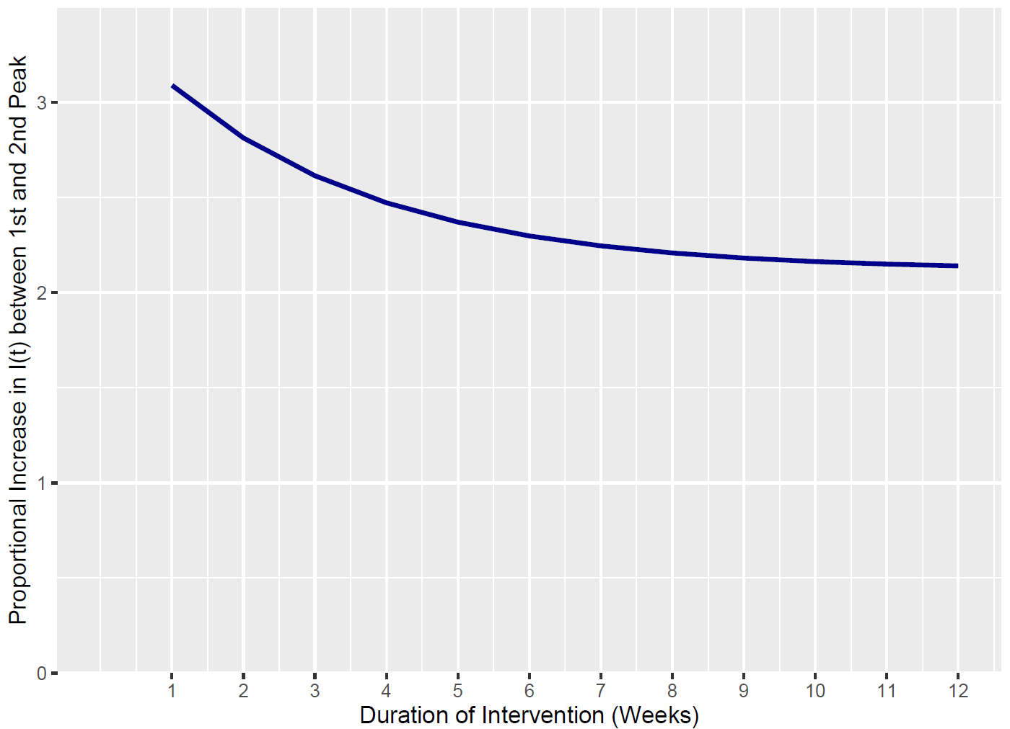
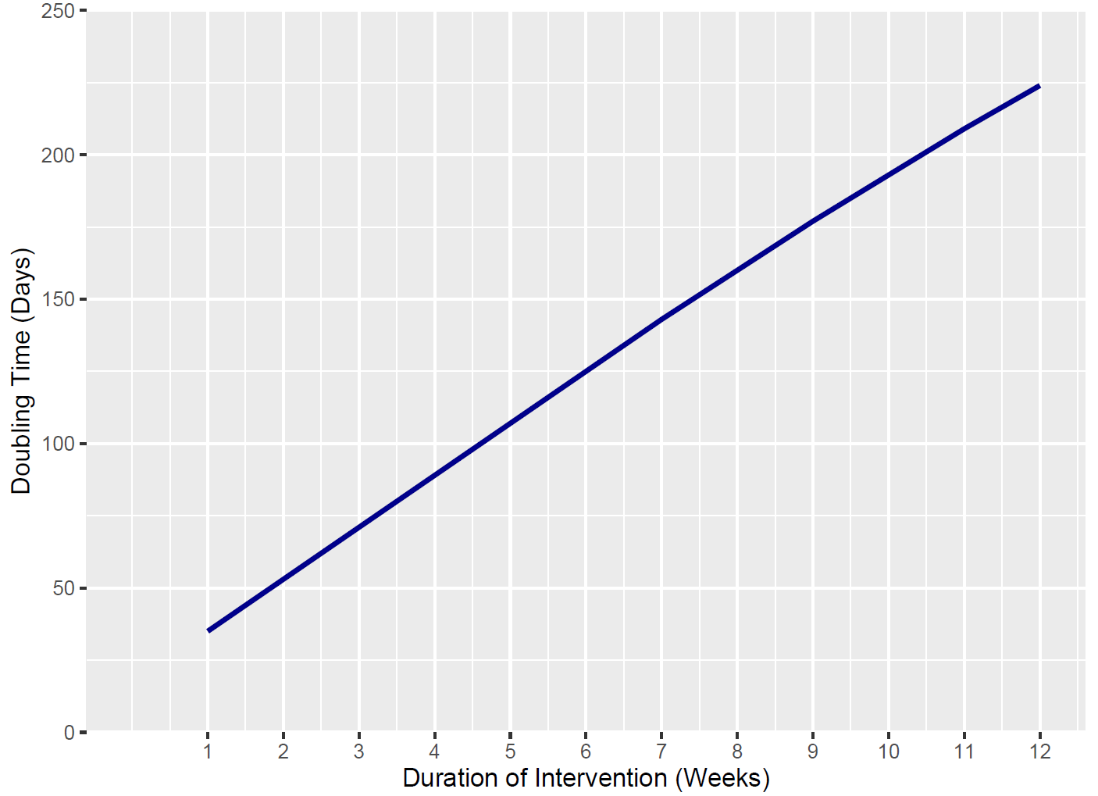
Doubling Time is calculated as the time between I(t) at the 1st Peak and when I(t) is double it’s value from the 1st Peak
Intervention Duration | I(t) First Peak | I(t) Second Peak | Relative Increase Between Peaks | Days Between Peaks | Daily % Increase in I(t) Required to Reach 2nd Peak from 1st Peak (Gradient) | Doubling Time
1 Week | 0.0182 | 0.056 | 3.091 | 64 | 4.829 | 35
2 Weeks | 0.0182 | 0.051 | 2.814 | 80 | 3.517 | 53
3 Weeks | 0.0182 | 0.047 | 2.615 | 96 | 2.724 | 71
4 Weeks | 0.0182 | 0.045 | 2.473 | 112 | 2.208 | 89
5 Weeks | 0.0182 | 0.043 | 2.371 | 128 | 1.852 | 107
6 Weeks | 0.0182 | 0.042 | 2.298 | 144 | 1.596 | 125
7 Weeks | 0.0182 | 0.041 | 2.246 | 160 | 1.404 | 143
8 Weeks | 0.0182 | 0.040 | 2.209 | 176 | 1.255 | 160
9 Weeks | 0.0182 | 0.040 | 2.182 | 192 | 1.137 | 177
10 Weeks | 0.0182 | 0.039 | 2.164 | 207 | 1.045 | 193
11 Weeks | 0.0182 | 0.039 | 2.151 | 222 | 0.969 | 209
12 Weeks (Baseline) | 0.0182 | 0.039 | 2.141 | 237 | 0.903 | 224

Slide 4
SIS Model – With Day 100 Trigger

Slide 5
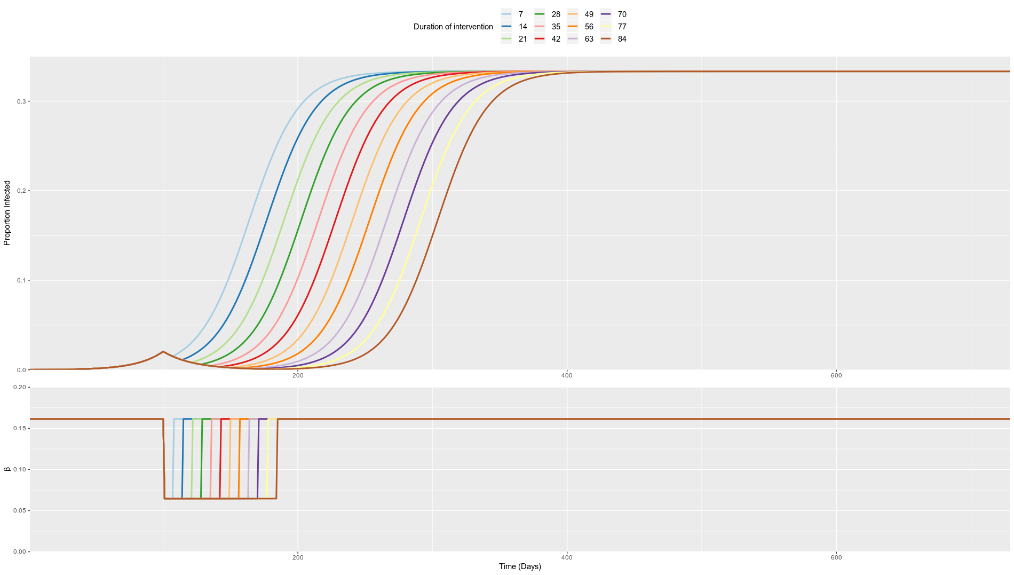
Time of Intervention Trigger =
100 Days (Week ~14.2)
Optimised timing for the two 12 week intervention scenario
I(t = 100) = 0.0204

Slide 6
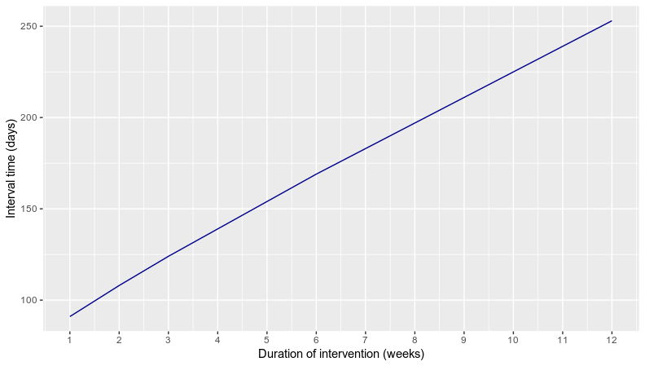
Time till slope fall-off is time between first triggerpoint (t) and point (t’) where slope of line between (t,I(t)) and (t’,I(t’)) is equal or bigger than dI/dt at t’ (with t’ > t).
I.e. there where the line touches the curve only once!
Intervention Duration | t’ | I(t’) | Time till slope fall-off
1 Week | 191 | 0.270718 | 91
2 Weeks | 208 | 0.281082 | 108
3 Weeks | 224 | 0.288128 | 124
4 Weeks | 239 | 0.292591 | 139
5 Weeks | 254 | 0.296749 | 154
6 Weeks | 269 | 0.300587 | 169
7 Weeks | 283 | 0.302624 | 183
8 Weeks | 297 | 0.304576 | 197
9 Weeks | 311 | 0.306422 | 211
10 Weeks | 325 | 0.308166 | 225
11 Weeks | 339 | 0.309808 | 239
12 Weeks (Baseline) | 353 | 0.311355 | 253

